Slide 1
SPRO1 Task 2: Programming

Slide 2
Little Primer – as you will work in the mechatronics lab

Slide 3

Consequences of electrical Shock

Slide 4

Guidelines
Always work with more people (never alone)
Use correct wires and probes
Wires and probes are connected without any electric source turned on
Modification of setup happens only without any electric source turned on
No food or drinking in the lab
Keep the lab tidy/clean up after yourselves

Slide 5
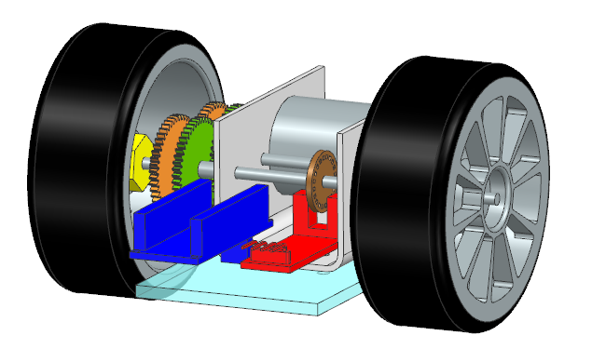
Embedded Programming
Connect the Arduino Nano Pins to the other boards
Check the pin descriptions and pinout
Pin layout can be found by searching for Arduino Nano and ATMega328p
Program the Arduino Nano in standard C language
You can use Laptop USB for Arduino Power Supply
Motor Power Supply – use Lab supply (Powerbank is also ok)

Slide 6
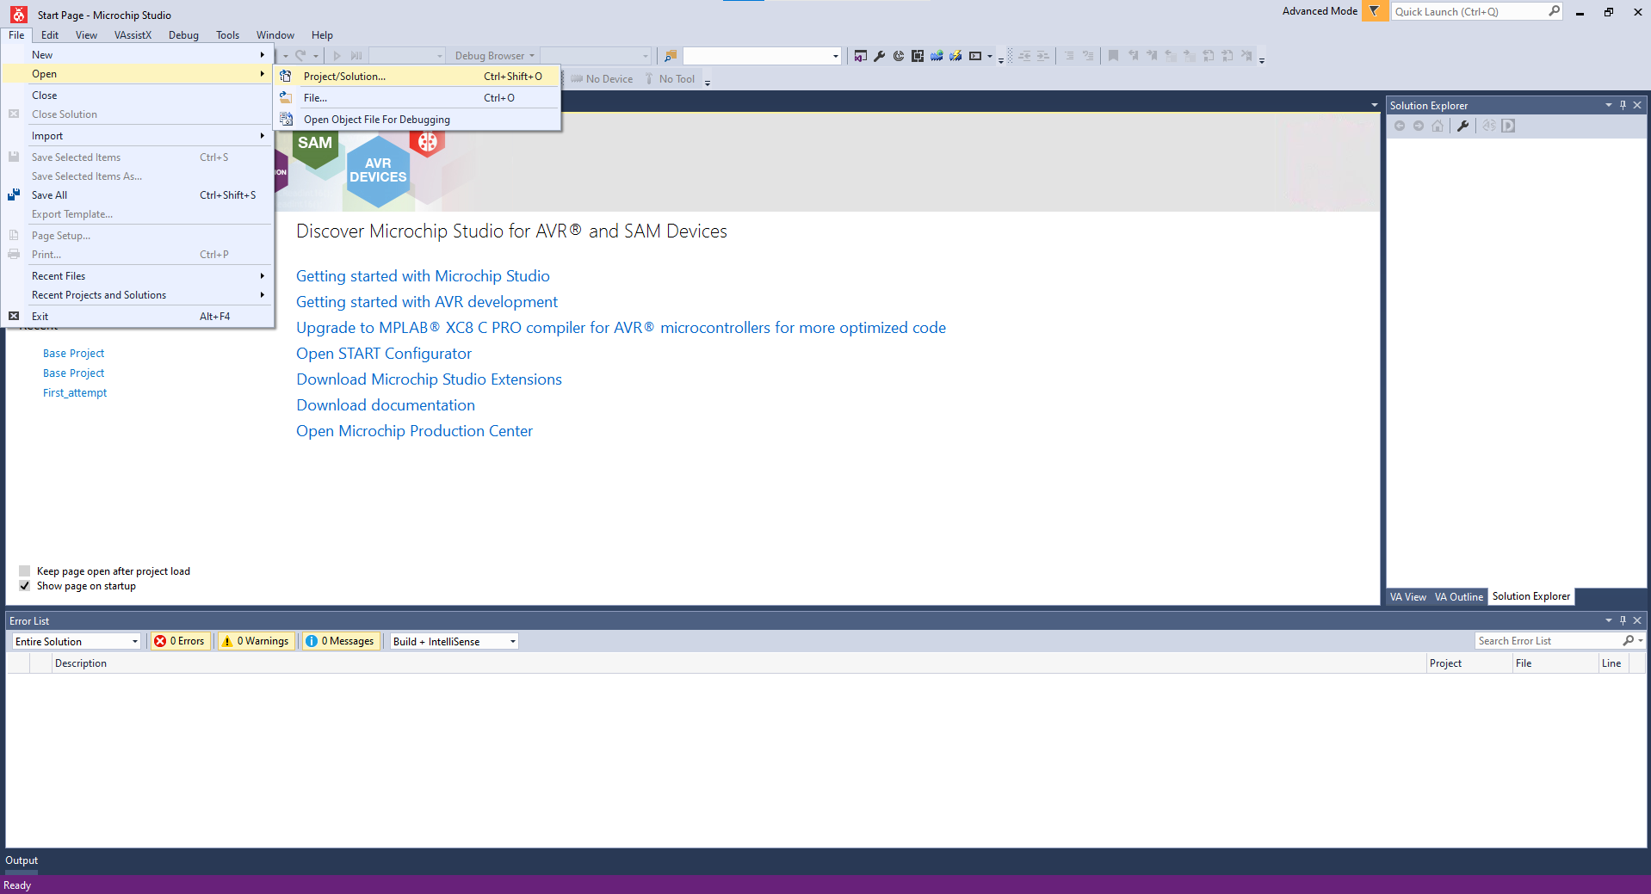
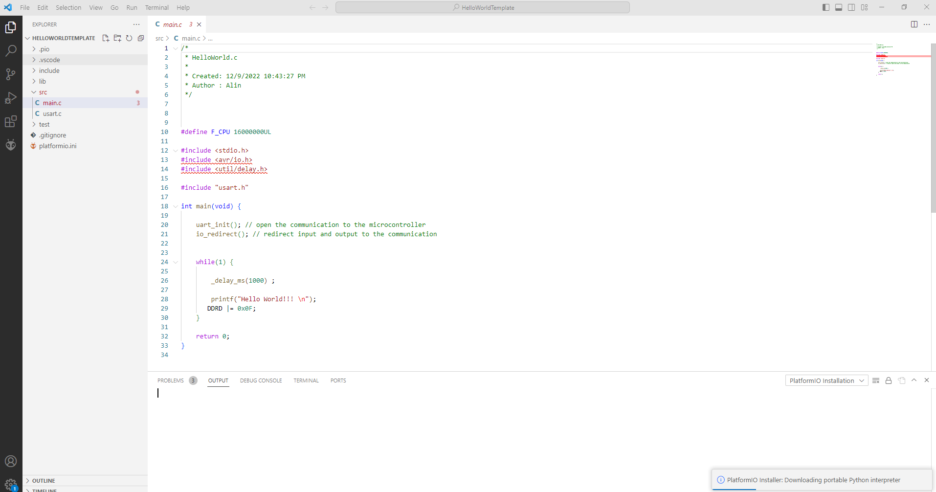
Programming – how to start
Install Arduino Software – can be Microchip Studio or Visual Studio Code as in Embedded 1.
Visual Studio Code – another option
Microchip Studio – one option

Slide 7
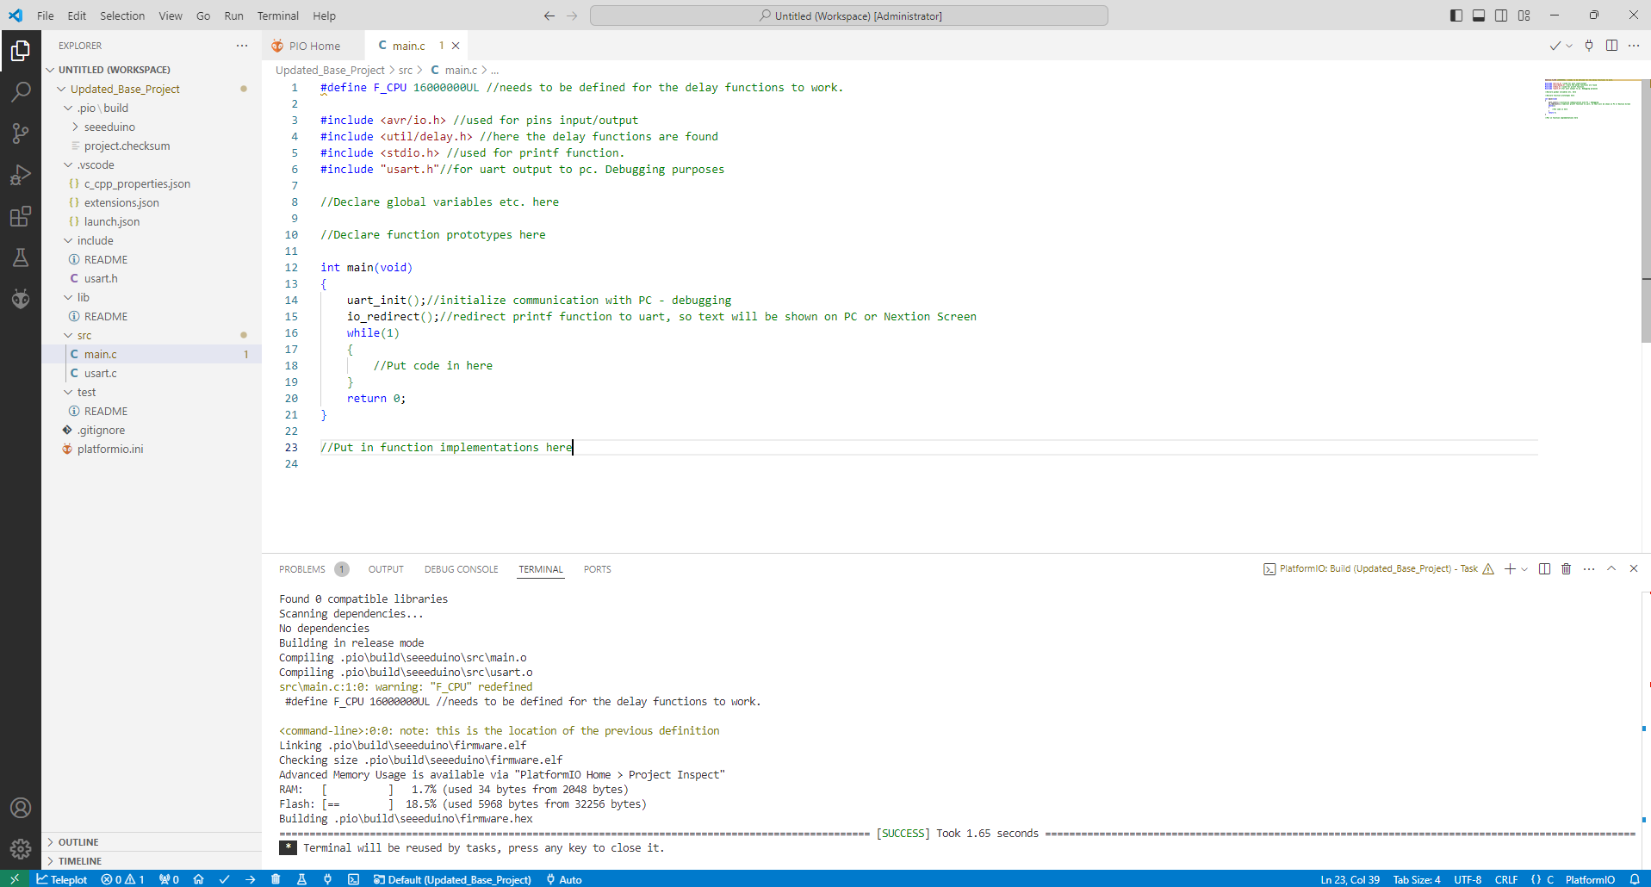
Leave #define and #include as they are
The green text, including ”//”, are comments.
This is free text and not compiled
Here you can set global variables. E.g. a pwm variable
The main function. Here your program starts executing
Functions to enable you to use printf to communicate with PC or display
These files are part of your project
We are working on the main file.
Visual Studio Code Example

Slide 8
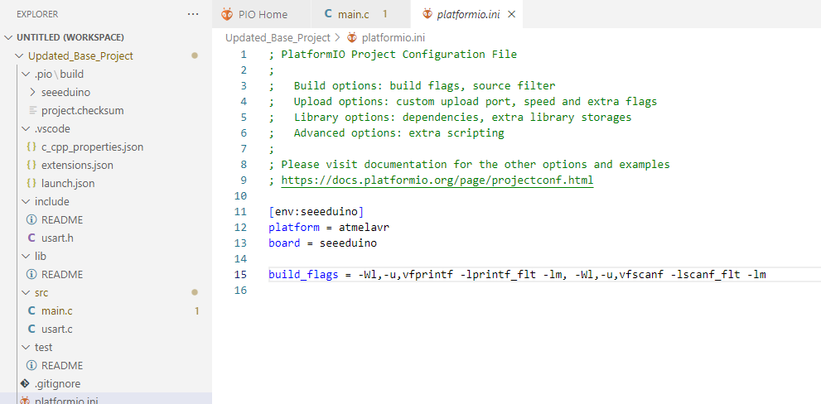
Platformio.ini
The build flags enable floating values when printing, using unsigned char by default and other things (the unsigned char is important for the display communication with the Nextion)

Slide 9
Small Example Code
#define F_CPU 16000000UL //needs to be defined for the delay functions to work.
#include <avr/io.h> //used for pins input/output
#include <util/delay.h> //here the delay functions are found
#include <stdio.h> //used for printf function.
#include "usart.h"//for uart output to pc. Debugging purposes
//Declare global variables etc. here
unsigned int seconds_counter = 0;
//Declare function prototypes here
void increase_seconds_counter(void);
int main(void)
{
uart_init();//initialize communication with PC - debugging
io_redirect();//redirect printf function to uart, so text will be shown on PC or Nextion Screen
while(1)
{
//Put code in here
printf("The program has been running for %d seconds\n", seconds_counter);
_delay_ms(1000);
increase_seconds_counter();
}
return 0;
}
//Put in function implementations here
void increase_seconds_counter(void)
{
seconds_counter = seconds_counter + 1;
}
We just want to count seconds. Create a global variable for that
We want a special function to do it for us. Tell the compiler to look for the function later
Send this text to the PC. More on printf on the next slide
Wait 1000 ms
Call function to increase the seconds counter
Here we write the actual function operations
Increase global variable by one

Slide 10
Printf – sending text to PC
IMPORTANT: The Baud Rate set up on the PC and the one on the Arduino have to be the same, otherwise it will not work! The same accounts for the Nextion Display when communicating with that
Function with arguments/parameters. Format is: printf(string, parameter1, parameter2,…)
%d: special indicator for ”decimal”. This converts value of first parameter to a text and inserts here
printf("The program has been running for %d seconds\n", seconds_counter);
String we want to send, including special indicators
Character for new line: \n
Note: printf also has specifiers for floating point numbers. We do not need it in the project, but Alin can tell you about it. It also requires some extra setup for the project as seen on the previous slide

Slide 11
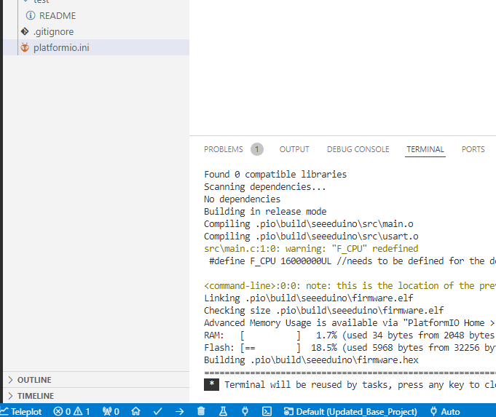
Compiling
Visual Studio Code: Compiling and deploying is done on the lower bar (checkmark and arrow)

Slide 12
Result
There is a built-in serial monitor
Play around with the code above.
You can copy paste this into the provided, empty, sample project and move on from there

Slide 13
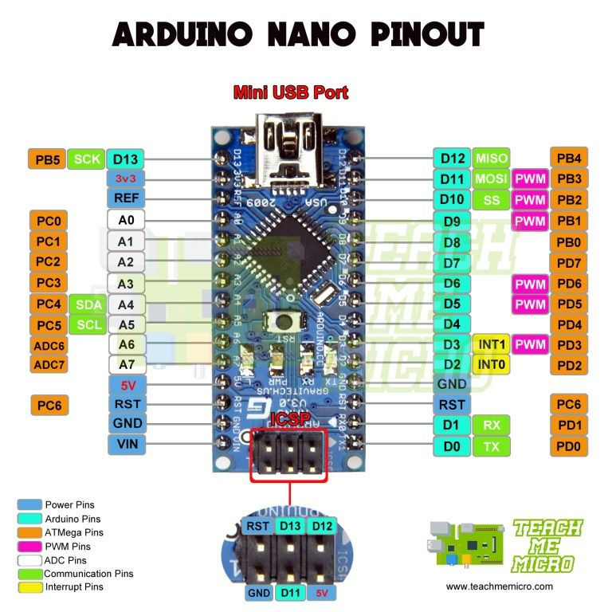
Arduino Pin layout
Orange indicators denote names of PINS as in datasheet
Magenta, Green, and yellow indicators denote alternate pin functions – more details later
Cyan and White indicators denote Arduino-specific names – we do not use these, but they are the ones indicated on the board

Slide 14
Overall tasks
Connection tasks:
Connect optocoupler to Arduino using PB0 to D0 output
Connect Arduino pin driver to L298 PD5 or PD6
Connect Display to UART ports
Programming tasks:
Enable Communication to Nextion LCD display
You should use the debug functionality of the LCD display software as well.
Enable Communication PWM output to control motor speed
Enable reading and timing with optocoupler board
Read voltage from ADC0 (PC0)
Overall:
Get motor to run and be able to program it to different speeds (not specified)
Measure the rotational speed using the optocoupler and encoder wheel from mechanical tasks.
Display the speed at the Nextion LCD screen
Display the measured voltage level on Nextion LCD screen

Slide 15
Specific Tasks
Individual tasks
Display two numbers on the Nextion Display using UART communication. One number should be integer and one should include decimal places. Start on the Nextion debugger, but should be on the display at the end
Read an integer number from the Nextion Display using UART communication. Start on the Nextion debugger, but should be on the display at the end (same as 1)
Measure time between two encoder wheel holes using the optocoupler. For this task, the resulting time can be sent to usual terminal.
Setup and read voltage on ADC0 (PC0) pin. This will measure battery voltage later, for now any voltage between 0 and 5 V is ok. Display on terminal is ok
Setup a PWM output on PD5 or PD6. Set up a desired frequency and a duty cycle of 20%. Connect to L298 module and observe changing motor speed
Detect a button press from the Nextion display, indicating to start the programm (i.e. make a ”start” button on the display and execute other tasks after this, for example measuring and displaying motor speed)
Combine the other results to display speed on display
(BSc of 8 members only) Measure analog voltage in, and determine the time between two voltage pulses when the voltage goes from 0 to 3.3 volts
Only BSc will use point 8 in the project period

Slide 16
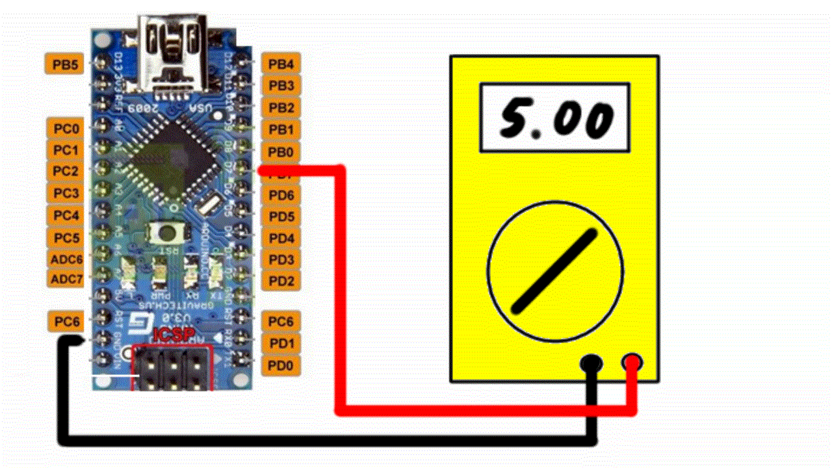
Signals, Pins, voltages – how does this work?
Select voltage levels commonly used:
24 V, 12 V, 5 V, 3.3 V
In digital signals, we use those voltage levels for communication. Either a pin has 5 V on it or 0 V (ground, GND)
If there is 5 V on it: Digital 1
If there is 0 V on it: Digital 0
For programming there are predefined variables:
DDRx sets the data direction (0=input / 1=output)
PORTx sets port value: high/low if output
PORTx enables internal pull-ups if input
Example:
DDRD = 0xFF;//Digital 0b11111111
PORTD = 0xF0;//Digital 0b11110000

Slide 17
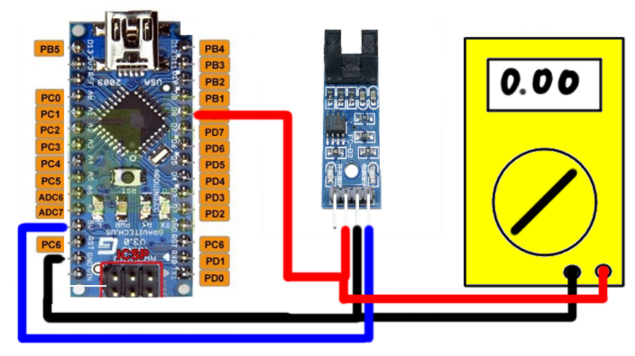
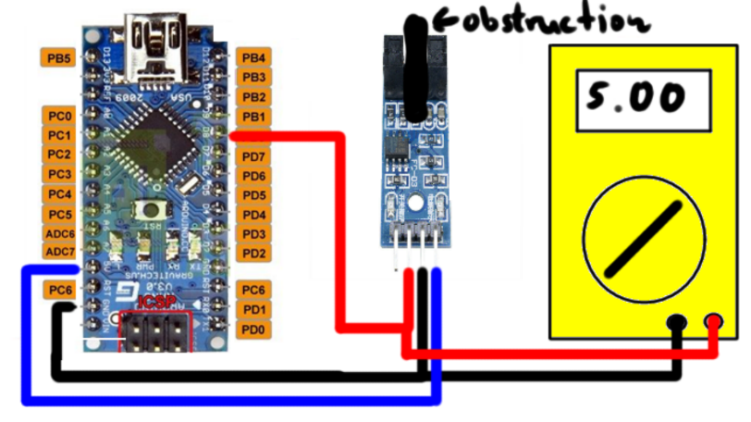
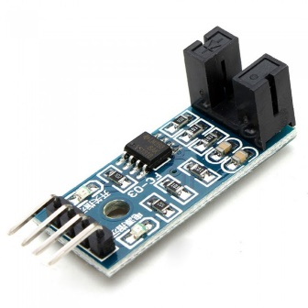
Optocoupler
Look at the pin descriptions on the board:
VCC: Supply voltage. Connect this to 5 V from Arduino – here blue indicator (usually red)
GND: Ground. Connect to GND pin from Arduino – here black indicator
DO: Digital Out – connect this to PB0 – here red indicator due to multimeter in the sketch
AO: Analogue out – leave open.
There is an LED on the board to indicate whether the optocoupler is open or blocked
Could be used for debugging

Slide 18
Optocoupler
Coding: PB0 has a special function if set up:
Can copy a counter value into a register when it changes from 0V to 5V or from 5V to 0V
Therefore, ideal to measure time difference between occurring holes

Slide 19
Pins and special functions in embedded
Pins usually can have multiple functions – see datasheet. The different ports and alternative functions can be found:
PB: Page 65
PC: Page 68
PD: Page 70
Small task:
We will need a function called ICP1 – which PIN will we have to use? Hint: can be found on this slide

Slide 20
There are also internal functions that operate ”in the background” once they are activated. We will need these three:
Analog to Digital Converter (ADC)
Timer/Counter 0 for PWM operation
Timer/Counter 1 to measure time
How to set up: Special function registers
Predefined registers you can read to and write from
Generally bit-wise!
Find in datasheet
Example: if we want ”normal mode of operation” and ”normal port operation”, what values to write in TCCR1A?
TCCR1A = 0x00;
From datasheet page 108 and 109

Slide 21
What about register TCCR1B
We would like to enable a noise canceler on the input pin
We would like to a positive edge to trigger a capture event
We would like a prescaler of 1024
Questions:
Which bits do we want to set to 1?
With a prescaler of 1024 and a crystal giving clock of 16MHz, how much time does one count amount to?
TCCR1B = (1 << ICNC1) | (1 << ICES1) | (1 << CS12) | (1 << CS10);

Slide 22
What happens with that timer/counter setup?
Counter starts in the background.
Increases by 1 every 1024/16000000 seconds (64 microseconds)
The increase happens no matter what the code is doing, so it is not disturbed
Can count to max two bytes, i.e. 65535
If a rising edge (change from 0V to 5V) is detected on PB0/ICP1 it copies the current counter value into special register ICR1. This value can be read later. Note that these are in principle two 8-byte registers, but the compiler will take care of that for us
//Setup timer/counter 1 as pure ticks counter, counting //clock ticks with 1024 prescaling; i.e. no interrupts
TCCR1A = 0x00;
TCCR1B = 0xC5; //Input capture on positive edge ICP1 pin (PB0). Filter is //enabled. 1024 clock prescaler
DDRB &= ~0x01;//PINB0 as input for ICP1 use
PORTB |= 0x01;//Enable pullup

Slide 23
Which strategy and registers to use for optocoupler?
You will need the following registers for the optocoupler challenge:
TCCR1A - configuration
TCCR1B – configuration
DDRB + PORTB – as seen above: PB0 should be an input with a pull-up enabled
TIFR1: ICF1 field in this register indicates that a rising edge on ICP1/PB0 has been detected. Fields needs to be writting high to reset
TCNT1 - actual counter value. Set to zero on each detected edge
ICR1 – value copied from TCNT1 on rising edge
Pages 108 to 113 in datasheet
Initialize:
TCCR1A
TCCR1B
DDRB+PORTB
TCNT1=0
Wait for ICF1 field to become 1
Reset TCNT1 and ICF1 field
Copy ICR1 variable into local variable
Display/send measured counts to Computer or Display

Slide 24
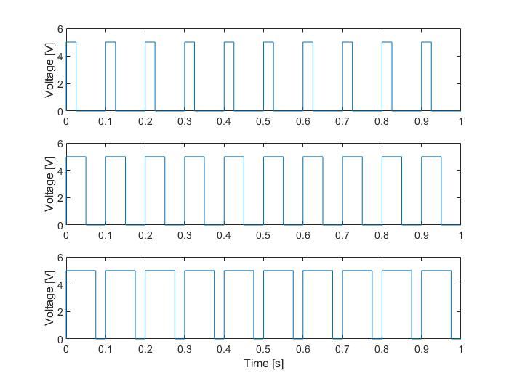
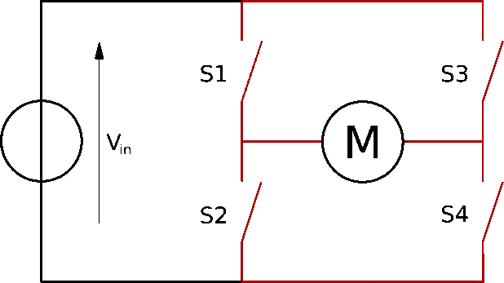
How does the Motor and PWM work?
What is a PWM signal?
Repeated signal either on or off (periodic)
Has a base frequency and duty cycle
Duty cycle between 0% and 100%
In practice certain percentages can be difficult to obtain in more advanced circuits – here it should be no problem
Combined with a filter (which a motor essentially is), a PWM can be regarded as an effective DC voltage.
Also used for controlling light intensity of LEDs (effective – our eyes are the “filter” here)
PWM has to be applied to an H-bridge to drive the motor
Three PWM signals: 25, 50 and 75%

Slide 25
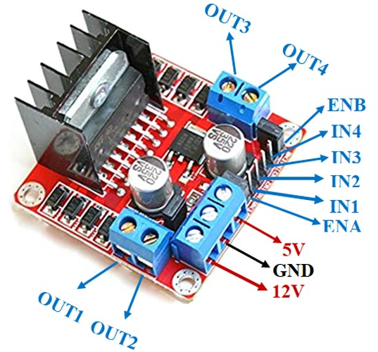
Motor and Motor Driver
Amplifier: The Arduino cannot run a motor
Logic to the left can drive up to two DC motors – we only need one here.
Diagram explanations:
small circles in front of AND gates denote inversion
AND gates are the semi-round symbols. Both inputs high means output high
FET Transistors (K-shaped with arrows). Behave like switches: Switch on if input high, else off.
Example: if
EnB is high (5V)
In4 is high (5V)
In 3 is low (0V)
Then
Output 3 is high
Output 4 is low
Motor direction can be switched
We can generate PWM by switching EnB on/off really fast
From L298N data sheet

Slide 26
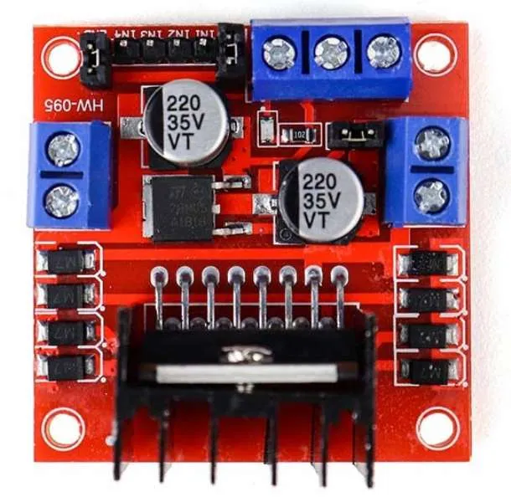
Motor and Motor Driver
Connections if we use Output B:
EnB 1 connect to PD6 (or PD5, can also be used)
In4 connect to 5V from Arduino
In3 connect to GND from Arduino
Remove Connector 5 (CON5)
+5V connect to 5V from Arduino
GND connect to GND from Arduino
+12V connect to power supply/battery
Out3 and Out4: connect to motor terminals
Notice: it may make sense to create an external board with a couple of GND and 5V connectors, so it is easier to connect the above.
Notice: This is the setup where we use the Arduino as 5V source. Later we will have our own 5V supply, then we connect 5V to that
Whether or not to use the 5V regulator in the motor driver is up to you - but it is most feasible not to, as we will get a more powerful one later – and please do not use two different ones, as there might be slight differences (4.95V vs 5.05 for example), and connecting those is not good.
The 2025 version is not red, but green! Otherwise the same

Slide 27
Motor and Motor Driver
How do we generate a PWM from Arduino?
Timers have functions to do that – they will toggle a pin based on a specific count
We will use timer/counter 0.
Once set up like timer 1 (just with different registers, and only 8 bit counting) it runs in background
Change in Duty Cycle is done by changing register OCR0A
PWM pin here are PD5 and PD6. Must be set up as output.
If count >255
Set count = 0
Count = count + 1
If count > OCR0A set PWM pin to 5V
Else set PWM pin to 0V
Principle of PWM generation. Runs in Background, you do not have to program this yourself
– you “just” have to set up the timer and update OCR0A

Slide 28
Motor and Motor Driver
Registers of interest (pages 84-88 in datasheet):
DDRD to set up output
TCCR0A
COM0A1 and COM0B1 should be set
WGM01 and WGM00 should be set
TCCR0B
WGM02 should be cleared
CS02 and CS00 should be set
OCR0A
At this counting value, the PWM pin is toggled
DDRD |=0x60;
//PWM Setup, see page 84 and following in datasheet for register description
TCCR0A |= 0xA3;//Fast PWM //mode with clear OC0A on compare match, set at bottom. Output B similar. //Page 84 and 86
TCCR0B |= 0x05;//1024 frequency scaling

Slide 29
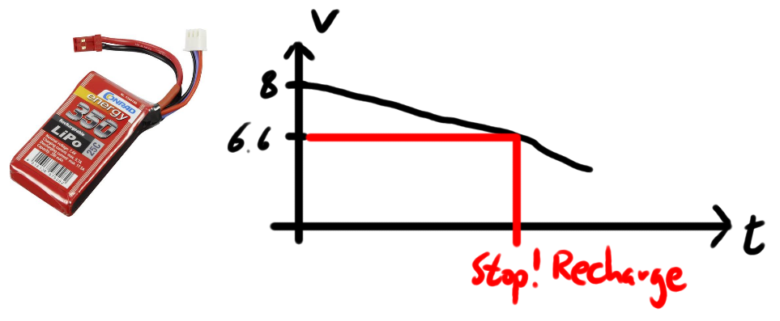
Analog to Digital conversion
Final purpose in this project:
Measure battery voltage and warn if voltage is too low
Background:
Battery voltage decreases when used
We use a device to convert to 5V so we do not know the actual battery voltage (approx. 9V)
Battery should not be discharged too much as this causes the voltage to become unstable
Practically
We use a voltage divider to reduce voltage to below 5V
We use an Analog to Digital Converter (ADC) to measure the voltage

Slide 30
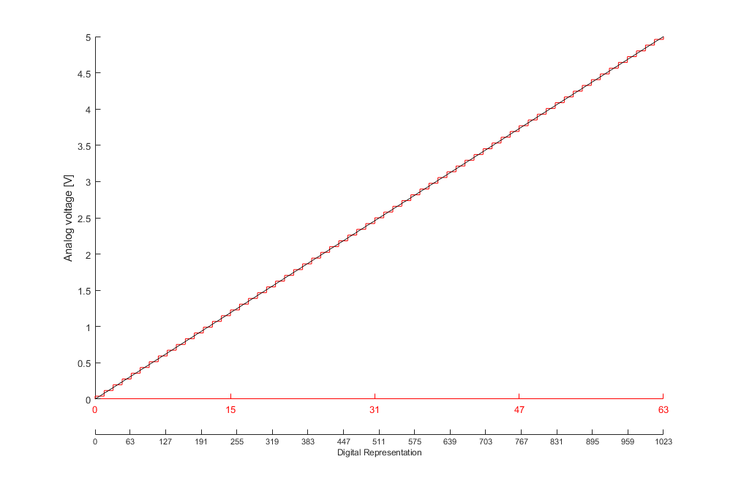
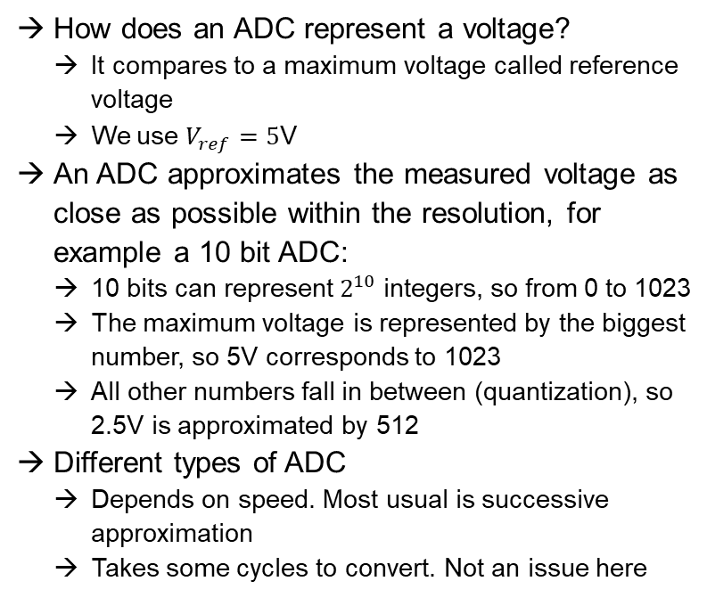
Analog to Digital conversion
How does an ADC represent a voltage?
It compares to a maximum voltage called reference voltage
We use $V_{ref}=5$V
An ADC approximates the measured voltage as close as possible within the resolution, for example a 10 bit ADC:
10 bits can represent $2^{10}$ integers, so from 0 to 1023
The maximum voltage is represented by the biggest number, so 5V corresponds to 1023
All other numbers fall in between (quantization), so 2.5V is approximated by 512
Different types of ADC
Depends on speed. Most usual is successive approximation
Takes some cycles to convert. Not an issue here

Slide 31
Analog to Digital conversion
Register descriptions in Datasheet 217-220
ADMUX – select which pin to measure on
ADCSRB – Which mode. We want free running
This means it is running in the background all the time and we just read off the latest result
ADCSRA
Enable the conversion, select input clock/prescaler
ADCL and ADCH
Converted voltage. Only lowest two bits of ADCH of interest along with all of ADCL. Always read ADCL first, so it is not safe to do this in a single operation
ADMUX = ADMUX | 0x40;//ADC0 single ended input on PortC0
ADCSRB = ADCSRB & (0xF8);//Free running mode
ADCSRA = ADCSRA | 0xE7; //Enable, Start conversion, slow input clock
unsigned int read_adc(void)
{
unsigned int adclow = ADCL;
return (adclow + ((ADCH & 0x03) << 8));//need to ensure that ADCL is //read first as it is not updated otherwise
}

Slide 32
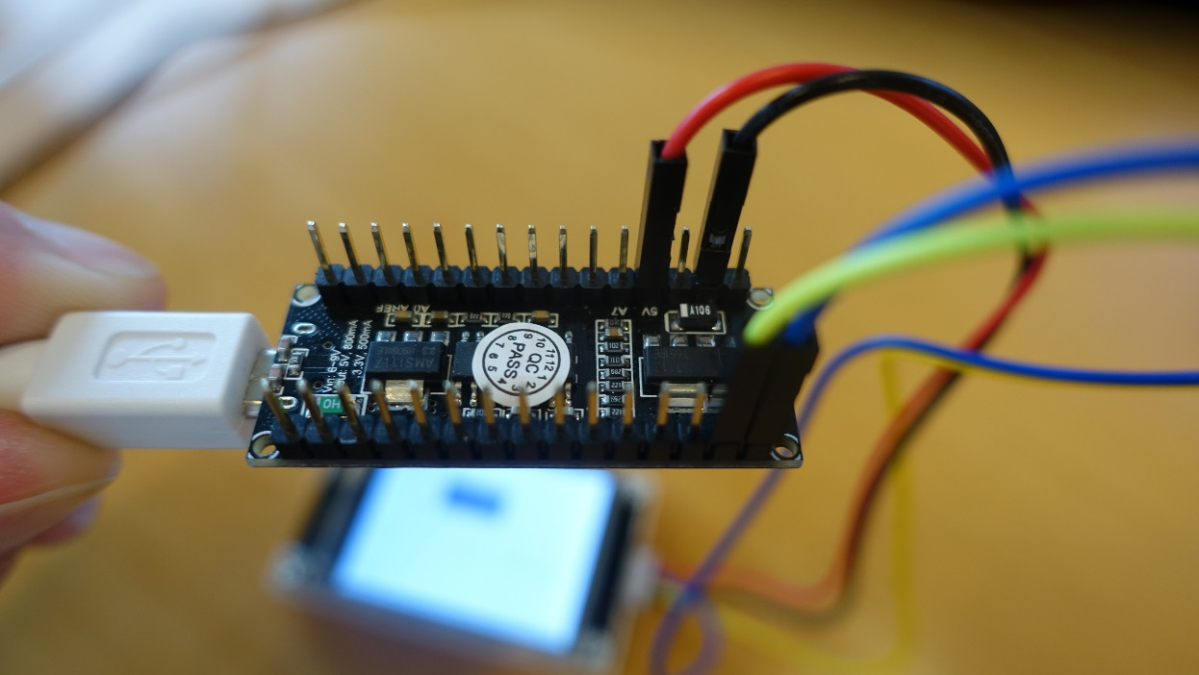
Nextion Display
Protocol with Serial communication and ASCII characters
Connect Blue and Yellow wire to PD0 and PD1
We are using them as RX and TX pin of UART communication
Connect Black wire to GND
Connect Red wire to 5V
You can find online libraries for Arduino – Do not use them! They will confuse you. Doing this yourselves is not as hard as you think
Use Nextion Software to create a user interface
For the debugger, sometimes you cannot see the whole window. This happens when your windows system has Zoom enabled – that will move parts of the window out of your screen. How will have to set screen zoom to 100%
Command set is found here:
https://nextion.tech/instruction-set/
You will mostly need variable setting like
page0.n0.val=10
In your C code it will look like
printf("page0.n0.val=10%c%c%c", 255,255,255);
The last three characters are flags and need to follow every command!
Connection from Arduino to display with nothing else connected

Slide 33
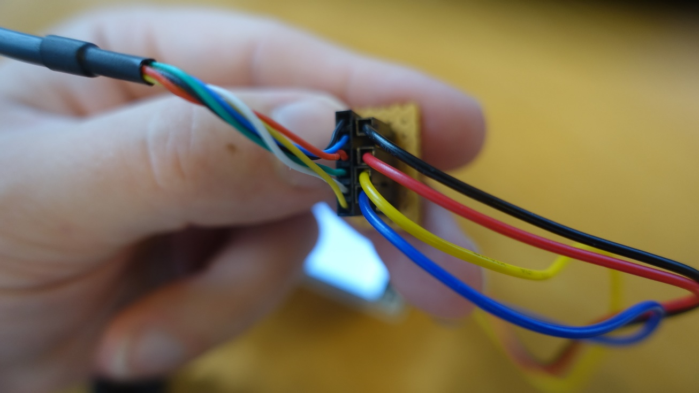
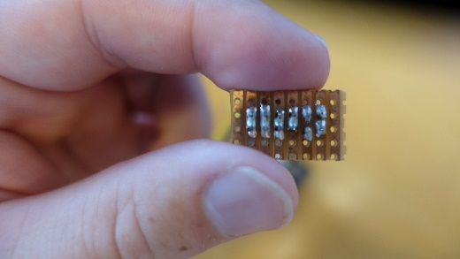
Nextion Display
Flashing the Display
Use the FTDI cable and connect as shown to the left
Note, depending on version, blue and yellow cables might be swapped
An extra connector board is used for this – backside shown lower right
Make your own connector board.

